Slide 1
JIT121 Programming Principles
Lecture 1
Unit Overview, Data Types and Variables

Slide 2
Teaching Staff
Lecturer:
Donna Teague:
d.teague@qut.edu.au
TA:
Haifeng Zhao:
zhf@jit.edu.cn

Slide 3
Pre-requisite
Building IT Systems (JIT104) (or equivalent)
  which provided hands-on experience with a variety of the computer languages used to build IT systems as well as a basic understanding of the way computer language code is written. The learning outcomes of such the pre-requisite provide evidence that you can:
  a. Identify and apply the principles and practices underlying some of the many computer languages used to build IT systems;
  b Apply appropriate processes and creative thinking to develop solutions to small IT challenges;
  c. Collaborate with your peers to solve non-trivial IT problems; and
  d. Communicate the results of your technical work in a form appropriate for an IT professional.

Slide 4
Goals of Unit
Further develop
  Knowledge of programming
    Procedural programming
    Object-oriented programming
  Problem-solving skills
  Skills at implementing solutions in the form of a program
    Using the C# programming language

Slide 5
Goals of this Lecture
Set teaching/learning expectations for this unit
Explore some of the skills needed to develop software
Introduce Visual Studio IDE
C# basics
Art of debugging

Slide 6
We assume that you…
want to succeed and are ready to start
can and will communicate if you don’t understand
can and will organise and manage your own time
  Set aside time to prepare for class
  Allocate time to complete exercises
  Find time to experiment and practise programming
know anything about how computers work
know about maths beyond basic algebra
We don’t assume that you…

Slide 7
Assessment Details
2 x problem solving + programming tasks (40%)
  Work individually
Final exam (60%)
  Open book exam
  Code-based questions:
    Writing; tracing; explaining; debugging…

Slide 8
Resources
Lecture slides list the major points
Tutorials
  Learn programming by doing
    experimenting; discovering; making mistakes;
Suggested textbook
  Doyle, B. (2014). C# Programming: From Problem Analysis to Program Design (4th ed.). Boston: CENGAGE Learning
  Or any other C# textbook
Visual Studio 2017 Community software

Slide 9
Why is algebra important?
Algebra involves manipulations of symbols which are modelling some event.
All programs are a model of something…

Slide 10
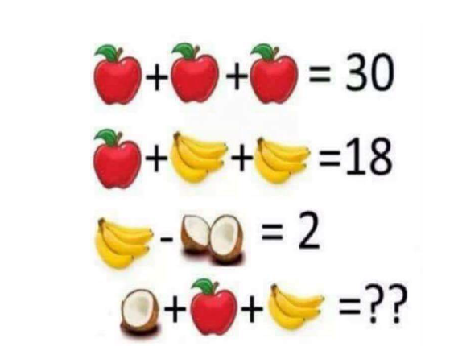
Algebra, modelling… and abstract representations

Slide 11
What is a Program?
A program contains instructions
The instructions are expressed in a programming language
  You may learn many programming languages
  Language is chosen based on the situation, such as the operating environment and system restrictions
The program takes input, processes it and generates output

Slide 12
Programming System
mixing and cooking
Process
(something
happens)
Input
Output
ingredients
cake

Slide 13
Computer Operations
Computers can do only 6 things!
Read information
Write information
Perform arithmetic
Store a value in memory
Compare two values and select one of two alternative actions
Repeat a sequence of actions while some condition is true

Slide 14
Syntax and Semantics
Every programming language has rules about how instructions are written
Syntax rules
  Which words and symbols are allowed
  How words and symbols can be combined
Semantic rules
  Every statement has a meaning
  Statements can be syntactically correct but not semantically correct eg:
  "Colourless green ideas sleep furiously" (Noam Chomsky)

Slide 15
Programming Cycle
Syntax/semantic errors
edit
compile
execute
runtime/logical errors
Compile ("build")
  Convert source code into machine instructions
  Syntax errors are detected by the compiler
  Semantic errors are picked up by the editor
Execute/run ("debug/start") the program
  Runtime errors detected during execution
  Logical errors detected (maybe) during execution

Slide 16
Integrated Development Environment
Use an IDE to create, compile and execute a program using the one system
We will use Visual Studio (VS) 2017 Community
  Microsoft software
  Includes .NET framework
  Allows the use of libraries which contain code that you can use in your program

Slide 17
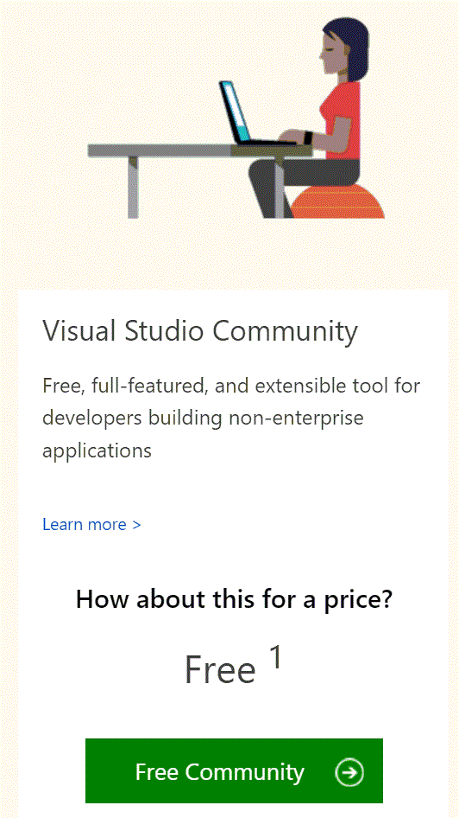
Visual Studio 2017 - Community
Free download
– after initial period of use, requires MS account login (also free) to continue use.
https://www.visualstudio.com/downloads/

Slide 18
Console Application from the inside out
In simple C# programs, all instructions are placed inside a method named Main
Instructions are executed sequentially from first to last
Main is enclosed within a class within a namespace
"enclosed" means within curly brackets or braces
{ … }
Good news! VS provides a program template whenever you start a new project (i.e. program)

Slide 19
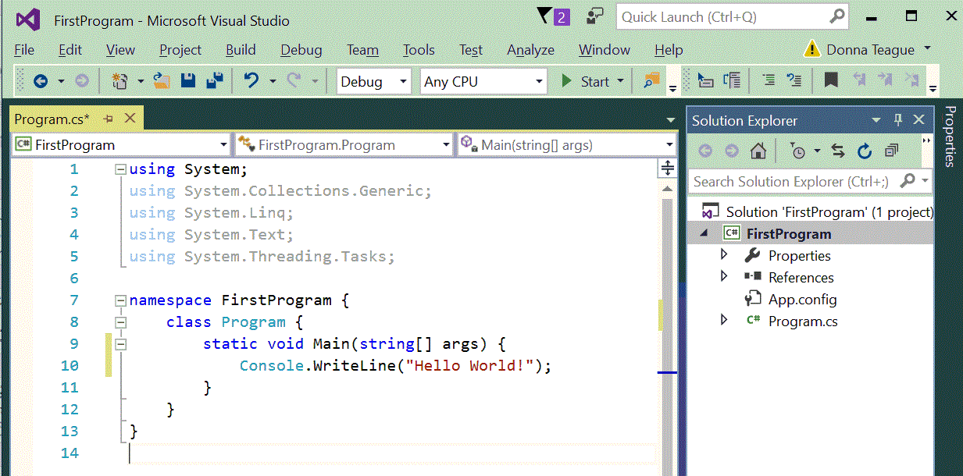
Simple Visual Studio
C# Program ("project")

Slide 20
Open up Visual Studio
Start a new "project" (a program)
Choose (Visual) C# as the language
At this stage, a CONSOLE project
Choose location of project:
  NOT a network drive
Make sensible naming choices
Wait for VS to work its magic…
Can now open via .sln file

Slide 21
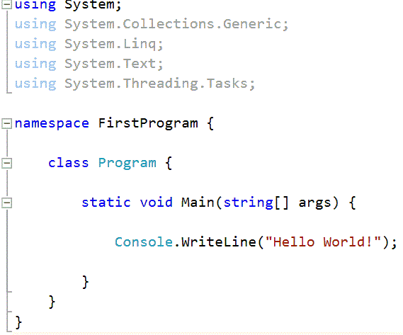
Simple C# Program ("project")
Using the System library
Name of the class
Main method
Every program must contain one Main method
Calls the Console library
WriteLine method
Method ends here
Class ends here

Slide 22
Console library
Provides simple input and output methods
Input from the keyboard – methods:
  Read reads a character
  ReadLine reads characters until the end of line
Output to the screen – methods:
  Write writes a string to the screen
  WriteLine writes a string to the screen and
  then moves to the next line

Slide 23
Variables
Store data in memory location
A variable has a name, a type and a value. Eg:
A variable's type must be declared explicitly (unlike Python)
This variable’s name is ‘number’, its type is int (integer) and its value is 23.
The data type will determine which arithmetic operations we can perform with the variable
  For example, we can't multiply two strings together
int number = 23;

Slide 24
Variable Declaration
In C#, a variable must be declared before it can be used (not like Python)
string username;
int total;
double average;
bool continuing;
These "variable declarations" give the variable a type and a name but not a value
Giving a variable a value is called "initialisation"
Don’t assume a variable has a default value
string (series of characters)
integer
decimal (floating point)
Boolean (logical)

Slide 25
Variable Names
Mix of letters (a..z, A..Z), digits (0..9) and underscore (“_”)
First character must be a letter or “_”
C# is case sensitive
  myname is not the same as myName
  https://docs.microsoft.com/en-us/dotnet/csharp/programming-guide/inside-a-program/identifier-names

Slide 26
Variable Names
Should be meaningful to help when reading code eg: total
Avoid abbreviations tot, ttl, t
C# Coding Style Guide
  Name starts with lower case letter
  Name consisting of two or more words use camel case totalAmount

Slide 27
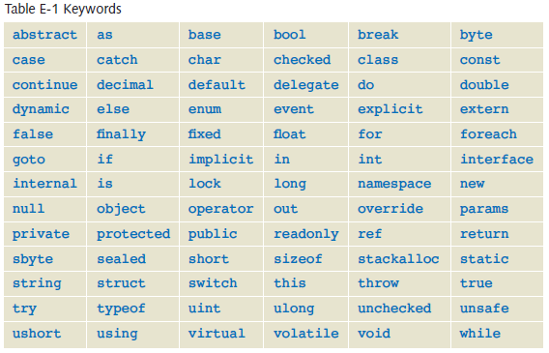
Reserved Words
Keywords and reserved words cannot be used as variable names
(Doyle, 2014)

Slide 28
Assignment Statement
Used to store a new value in a variable
  variableId = expression;
Semantics
  Calculate the value of the expression on the right
  Store that value in the variable on the left
  Only a variable can be on the left of the = operator
  total = 0;
  total = total + 1;
  username = "Fred";

Slide 29
Keyboard Input
  Always prompt when expecting user input:
Console.Write("Enter ... ");
Keyboard input methods:
ReadLine() reads a sequence of characters (including newline) eg:
string username = Console.ReadLine();
Don’t use Read() reads a single character
ReadKey() keeps Console window open (or use Ctrl+F5)

Slide 30
Numeric Input
How do we read numbers from the keyboard?
  Console.ReadLine() method reads strings
  We need to parse* the strings to convert into numbers
int.Parse method is used for integers
  int myNumber = int.Parse(Console.ReadLine());
double.Parse method is used for doubles
  double myNumber = double.Parse(Console.ReadLine());
Definition:
*parse: take some data and extract meaning from it.
In C#, we parse strings to produce a numeric representations

Slide 31
Simple Numeric Input
Input an integer:
int amount;
string response;
Console.Write("Enter a number: ");
response = Console.ReadLine();
amount = int.Parse(response);
Alternatively, read and parse in one step:
int amount;
Console.Write("Enter a number: "); amount = int.Parse(Console.ReadLine());
// Program will crash if user enters a non-numeric value

Slide 32
Simple Numeric Input
Input a double:
double number;
Console.Write("…");
number = double.Parse(Console.ReadLine());
// Program will crash if user enters a non-numeric value

Slide 33
Formatted Output
Use Write() or WriteLine() methods to output ints and doubles
  Console.WriteLine(myNumber);
  Console.WriteLine("Answer is " + myNumber);
But! The answer will include all decimal places
  If you want to change how many decimal places are shown:
    can use Math.Round method; or
    format the output…

Slide 34
Formatted Output
Using string concatenation:
Console.WriteLine("one option " + first " with concatenated strings " + second);
Alternative: Using placeholders:
Console.WriteLine("option {0} with embedded placeholders {1}", first, second);

Slide 35
Placeholders
Placeholders in strings are used to indicate where a value will be placed in the output.
Indexed from 0, enclosed in braces e.g.: {0} then {1} etc.
values are comma-separated arguments following the string literal
the number of placeholders must match the number of value arguments supplied eg:
Console.WriteLine("Answer is {0}", result);
Console.WriteLine("Hello {0} and {1}", firstPerson, secondPerson);

Slide 36
Placeholder Syntax
{<placeholder number>[, <width>][:<format specifier><# digits>]}
eg:
fixed point decimal with 2 decimal places:
Console.WriteLine("Area is {0:F2}", Area(radius));
scientific notation with 3 decimal places
  Console.WriteLine("Area is {0:e3}", Area(radius));
scientific notation or fixed point decimal(whichever is shorter)
Console.WriteLine("Area is {0:g}", Area(radius));
fixed point decimal (2 places), occupying 9 spaces
Console.WriteLine("Area is {0,9:F2}", Area(radius));
fixed point decimal (2 places), occupying 9 spaces - Justify left
Console.WriteLine("Area is {0,-9:F2}", Area(radius));
Currency ($ and 2 decimal places)
Console.WriteLine("Budget is {0:c}", budget);
+width means right justified; -width means left justified

Slide 37
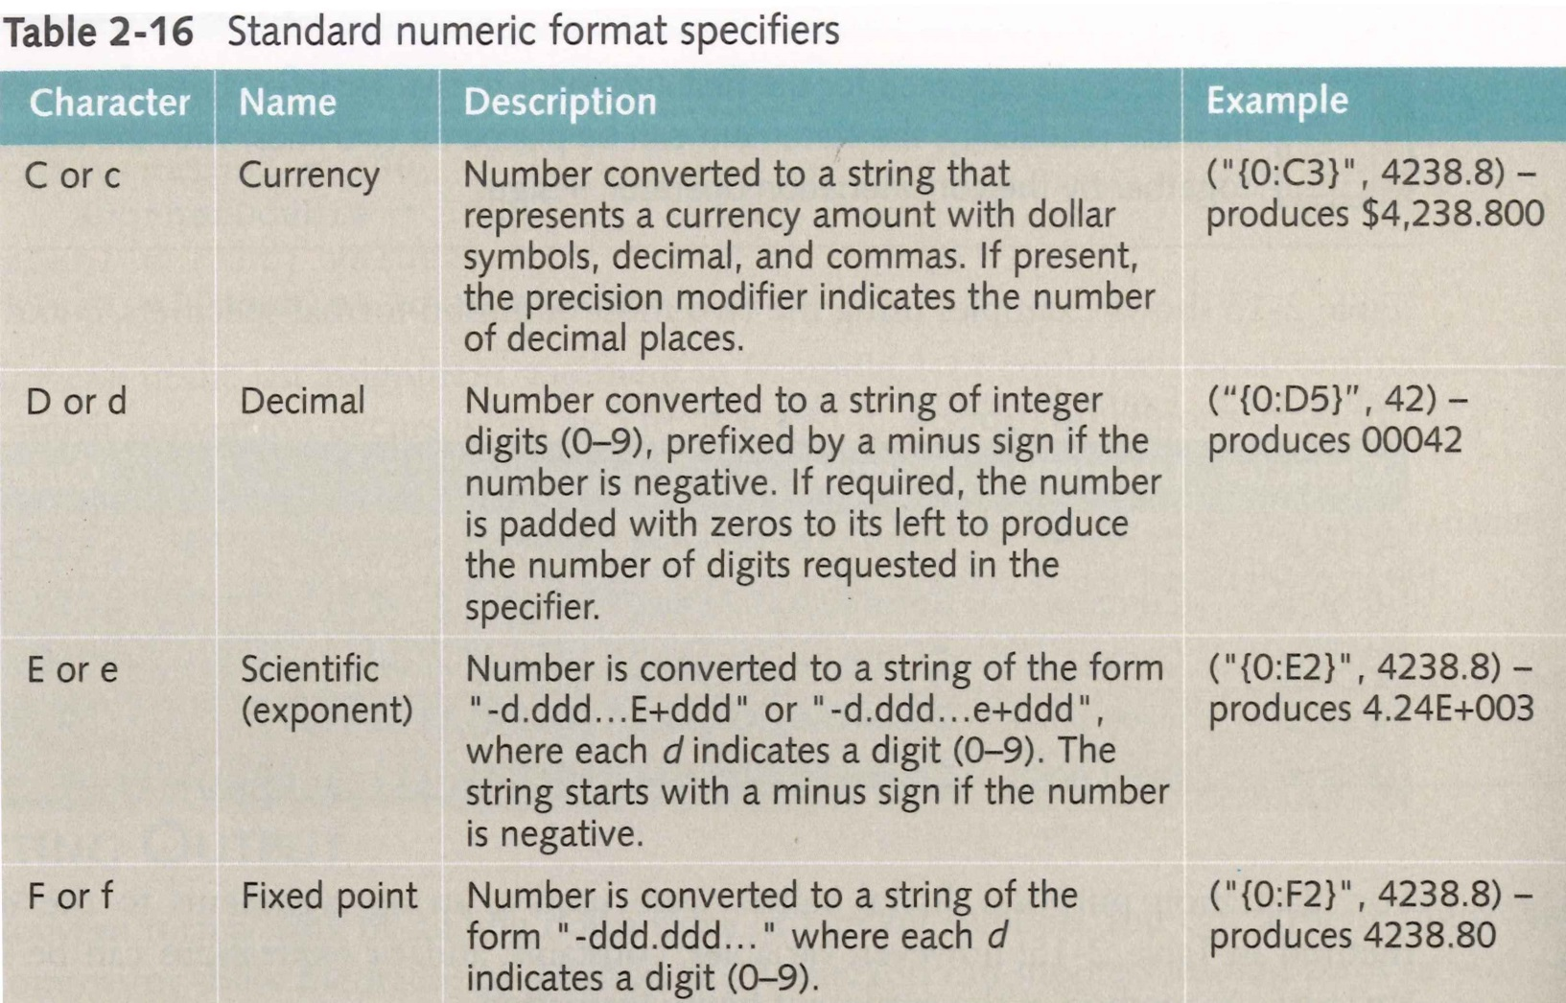
Formatting Numeric Output

Slide 38
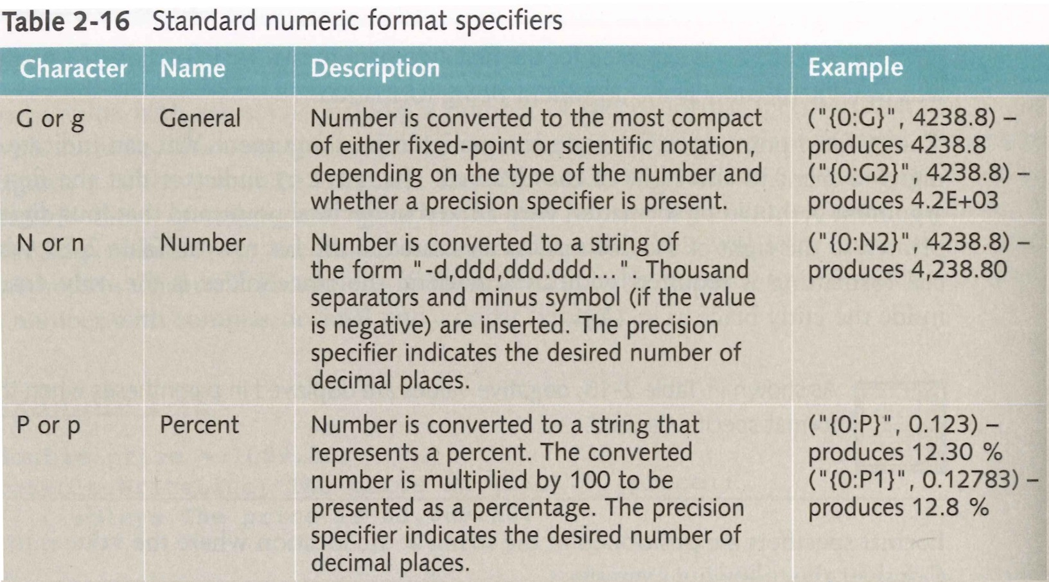
Formatting Numeric Output

Slide 39
Examples of Formatted Output
  double value = 4.2;
Example with all decimal places
  Console.WriteLine("Answer is {0}", value);
Examples of formatted output
  Console.WriteLine("Answer is {0:c}", value);
    Displays the answer as currency (e.g. $4.20)
  Console.WriteLine("Answer is {0:f3}", value);
    Displays the answer with 3 (fixed) decimal places
  Console.WriteLine("Answer is {0:p}", value);
    Displays the answer as a percentage (e.g. 4.20%)
  {n} is a placeholder
  "c" is a format specifier
  "3" specifies number of decimal places

Slide 40
Activity: Learning Check!
Write code to create a variable with the value 1.688
Then write code which will output that same variable in each of the following formats:
    Number is 1.7
    Number is $1.69
    Number is 168.80 %
    Number is 2
    Number is 1.69e+000
Write code to create a variable with the value 2.47
Write code to output both variables' values as follows:
      The first number is 1.7 and the second number is 2.470.

Slide 41
Integer arithmetic semantics
  Addition +
  Subtraction -
  Multiplication *
in C# are just like a calculator
But integer division / is different:
  10 / 3 → 3
  5 / 6 → 0
  14 / 8 → 1
  NB: Dividing by 0 generates runtime error.

Slide 42
Precedence matters!
BOMDAS: https://msdn.microsoft.com/en-us/library/2bxt6kc4.aspx
An expression like:
a * b – c * d + 5 * e * f / g
is evaluated as:
((a * b) – (c * d)) + (((5 * e) * f) / g)
Use parentheses () to ensure the calculation is performed in the order you expect
No restriction on the number of parentheses that you can use

Slide 43
Integer Arithmetic
If an expression involves only integers, the result is an integer
Addition, subtraction and multiplication work in C# just like a calculator
But integer division is different
10 / 3 = 3 5 / 6 = 0 14 / 8 = 1
Fractional/decimal part is lost!
Division by zero is undefined (run-time error)

Slide 44
Arithmetic operator - modulus
  Modulus (or ‘mod’, or 'modulo') %
returns the remainder after division
17 % 3 → 2
5 % 4 → 1
5 % 5 → 0
25 % 7 → 4
6 % 9 → 6
• No "power" or "exponential" operator

Slide 45
Double Arithmetic
If expression is a mix of int and double, result is of type double
However intermediate calculations may produce unexpected result
• Volume of a Sphere = 4/3 π r3
  double r, volume;
  r = ... ;
volume = (4/3) * Math.PI *r*r*r;
Use of integers! What does 4 / 3 evaluate to?

Slide 46
Operator abbreviations
Common short forms
++ increment (increase) by 1 the value stored in the variable eg:
x++ is equivalent to x = x + 1
-- decrement (decrease) by 1 the value stored in the variable eg:
    y-- is equivalent to y = y – 1

Slide 47
Operator abbreviations
Common short forms
+= increase the value stored in the variable by the value on the RHS eg:
z += 2 is equivalent to z = z + 2
-= decrease the value stored in the variable by the value on the RHS eg:
a -= 3 is equivalent to a = a - 3
*= increase the value stored in the variable by multiplying it by the value on the RHS eg:
b *= 10 is equivalent to b = b * 10

Slide 48
Operator abbreviations - beware
Increment and decrement operators can be used before or after the variable.
Postfix use: n = 2;
  temp = 7 * n++;
Here n++ means use the current value of n in the expression, and then increment n afterwards. So after this calculation, temp is 14 and n is 3.
Prefix use: n = 2;
temp = 7 * ++n;
Here ++n means increment the value of n and use the updated value. So after this calculation, temp is 21 and n is 3.

Slide 49
More C# operators
relational operators (returns Boolean value)
  < less than?
  <= less than or equal to?
  > greater than?
  >= great than or equal to?
equality operators (returns Boolean value)
  == is equal to?
  != is not equal to?

Slide 50
More C# operators
conditional operators (returns Boolean value)
  && and
  || or
  ! not
Python allows: (0 <= value <= 2) but not C#!
Instead write: ((0 <= value) && ( value <= 2))

Slide 51
Value and Reference Data Types
Value types
  data stored in a memory location
e.g. int, double, bool, char
Reference type
  holds the address of the memory location in which the data is stored
e.g. string
int value = 42; string name = "Barbara Doyle";
value
name
42
Barbara Doyle

Slide 52
string immutability
Each string is immutable
  It cannot be changed after it has been created
Immutability is important, but tricky
  Misunderstanding this will give you some surprising bugs
  While there are many times when you seem to be modifying a string, C# is actually creating a new string for you

Slide 53
Immutability Example
string names = "Marge";
names = name + " and Homer";
Console.WriteLine (names);
Displays "Marge and Homer"
names
M
a
r
g
e
After first line is executed
M
a
r
g
e
a
n
d
H
o
m
e
r
After second line is executed

Slide 54
Immutability Bug
Because strings are immutable, the string class' methods never affect the data that a particular string contains
This often causes bugs in beginners' code, for example:
    string letters = "ABC";
    letters.ToLower(); // Convert string to lower-case
  ToLower() will not change the "ABC" value that letters contains. Instead, a new string is created and given the value "abc".
    A reference to this new string object is returned by the ToLower() method. But the above code makes no use of that returned reference, so the new string is discarded.
To make letters contain the value "abc", we must say:
    letters = letters.ToLower();
  Now letters references a new string object that contains "abc"

Slide 55
Logical Expressions Revisited
Logical expressions produce a Boolean result
  These can only be true or false
Declaring and initialising a Boolean variable:
    bool continue = false;
Logical operators:
  ! NOT
  && AND
  || OR
  ! has the highest precedence
  && has higher precedence than ||

Slide 56
Evaluating Logical Expressions
A and B represent two Boolean variables or expressions
(A && B) is true iff both A, B are true
If either of A, B are false, then (A && B) is false
AND truth table:
 | AND |  | result
true |  | true | true
true |  | false | false
false |  | true | false
false |  | false | false

Slide 57
Evaluating Logical Expressions
(A || B) is true iff either (or both) of A, B are true
If both of A, B are false, then (A || B) is false
OR truth table:
(!A) is false if A is true, and true if A is false
 | OR |  | result
true |  | true | true
true |  | false | true
false |  | true | true
false |  | false | false

Slide 58
Evaluating Logical Expressions
NOT truth table:
(!A) is false if A is true, and true if A is false
NOT | result
true | false
false | true

Slide 59
Short Circuit Evaluation of Logical Expression
Only as much of an expression as necessary is considered in order to determine the truth value of the expression e.g.:
(A && B) – if A is false then && is false
(A || B) – if A is true then || is true
AND : Only true when both are true
OR : Only false when both are false

Slide 60
Activity: Some logical expressions
What do each of these expressions evaluate to when number is assigned the value 6?
((0 <= number) && (number <= 4))
((0 <= number) || (number <= 4))
((0 <= number) && (4 <= number))
((number <= 0) && (4 <= number))
...
...
...
...

Slide 61
Bitwise Operators
Do not confuse
  && with &
  || with |
& and | are bitwise operators
Same result as logical operators if used on Boolean expressions
But also work on int and char with "unusual results"
  (60 & 13) → 12
  (60 | 13) → 61
https://msdn.microsoft.com/en-us/library/17zwb64t.aspx

Slide 62
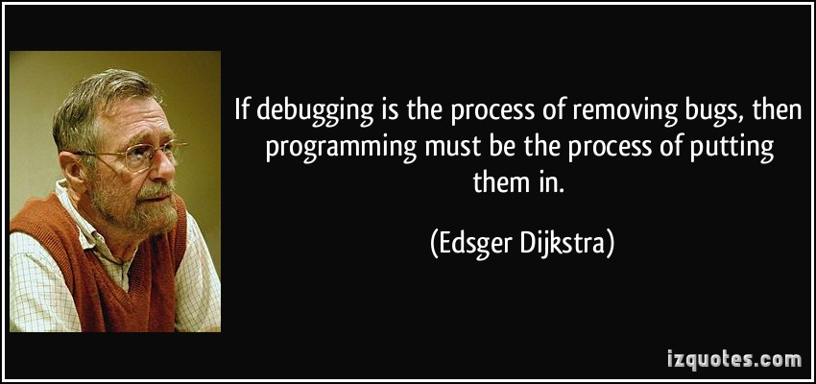

Slide 63
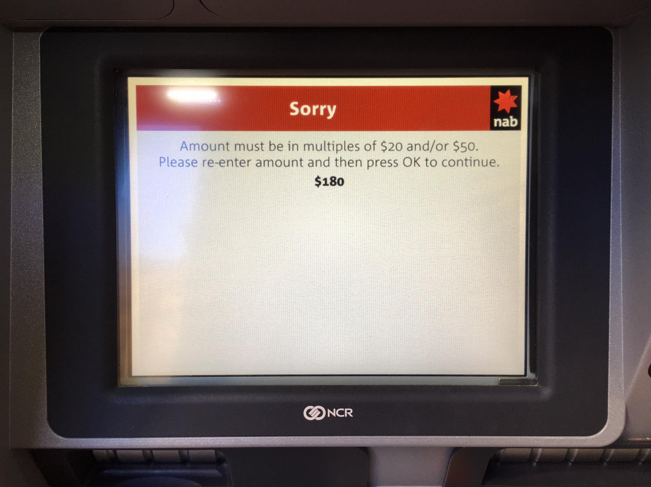

Slide 64
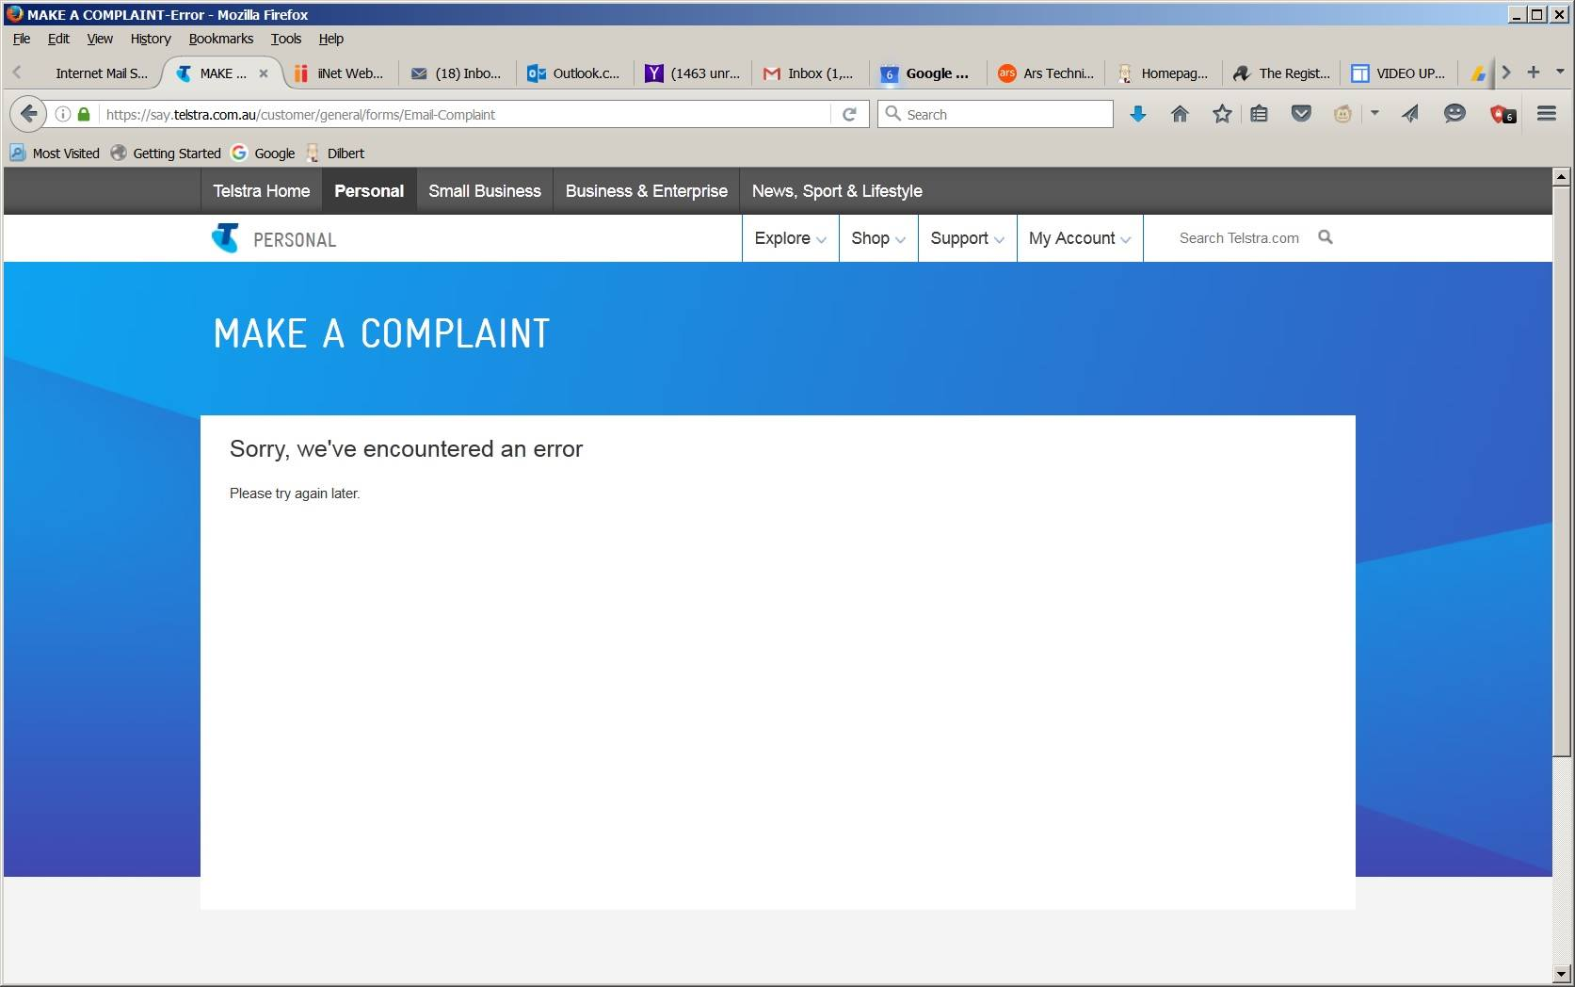

Slide 65
Semantic misunderstanding
Very common when new to a language or using some feature for the first time
Some examples of the kinds of things you might believe are true:
  at a certain point in your program, a variable has a certain value (when it doesn't)
  in an if‐else statement, the if block is always executed
  when you call a certain method, the method returns a value that you were "expecting"
  That code works in particular ways
  int i = 99;
  i = i++; //value of i after this statement is …
✗
✗
✗
Notes:
postfix increment operation: The result of the operation is the value of the operand before it has been incremented.
http://stackoverflow.com/questions/6716189/i-i-doesnt-increment-i-why
i = 0;
i = i++;
The behavior is well defined in C# and the evaluation order is:
Left side i is evaluated to the variable i
Right side is evaluated to 0, and i is incremented (now i==1)
The assignment is executed, it sets i to 0. (now i==0)
The end result is i==0.
In general you first create an expression tree. To evaluate it you evaluate first the left side, then the right side and finally the operation at the root. Do that recursively.

Slide 66
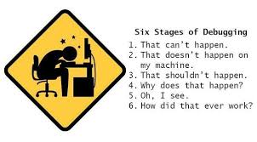
Six Stages of Debugging
- ANONYMOUS

Slide 67
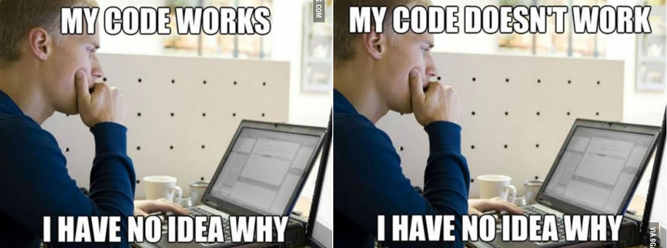
Testing & Debugging is a Challenge
  Don't change your code without really having a good reason for that particular change ("hit and miss").
  Even if you're lucky and fix the bug, you'll often create a new bug or two at the same time.

Slide 68
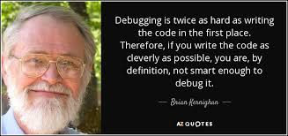

Slide 69

What not to do….

Slide 70
How to Debug: an Overall Approach
A systematic approach to debugging can eliminate, or at least significantly reduce, the frustration many programmers feel when their program doesn't work
Overall approach:
  Step 1: Duplicate the bug
  Step 2: Divide and Conquer
  Step 3: Explain Your Code to Someone Else
  Step 4: Change Your Code
  Step 5: Check That the Bug Is Fixed

Slide 71
Step 1: Duplicate the Bug
✓
Get the bug to occur in a reproducible way
  i.e. getting the bug to occur whenever you want it to
In small programs, this often occurs whenever you enter some particular value
In bigger programs, this is harder. The bug may only occur in special situations, such as when the user has entered a particular sequence of values/operations.
  For example, ATM withdrawals work correctly when that's all you do, but they don't work correctly after you've done a transfer

Slide 72
Step 2: Divide and Conquer
✓
Try to narrow down the parts of your program in which the bug might be occurring.
In some cases, this is easy. In other cases, it is harder.
For example:
  Program stops because an exception occurs, then the Debugger can give you direct information as to what your program was trying to do at the time
  If you've just changed a part of your program and a new bug occurs, then it is highly likely that there is something wrong in that new code

Slide 73
Step 2: Divide and Conquer (cont'd)
Debugging is often easier when you have taken time to check that methods are working correctly through incremental development, implementation and testing
  When your program has method(s) that input some data, check that those input method(s) are correct, before you start manipulating the data returned by those method(s).
It is fairly common to stare for hours at a program, manipulating incorrect data – it is hard to find the error when you are looking at the wrong code.
  By checking each method separately, you can isolate most errors and save a lot of time.

Slide 74
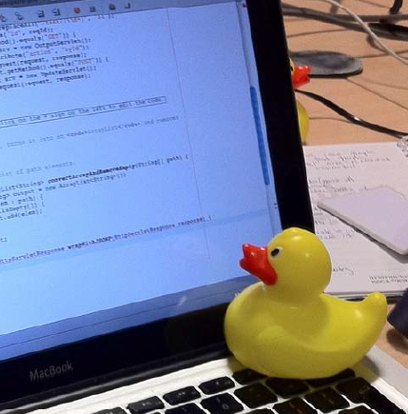
Step 3: Explain Your Code to Someone
✓
An effective technique is to explain your code to someone else. This will often cause you to explain the bug to yourself.
  You can even use non-programmers as listeners
One university computer centre kept a teddy bear near the help desk.
  Students with mysterious bugs were required to explain them to the bear before they could speak to a human adviser. (Brian Kernighan and Rob Pike, The Practice of Programming, 1999)
  This technique has been re‐invented many times,
  and has many names, such as Rubber duck
  debugging
  (http://en.wikipedia.org/wiki/Rubber_duck_debugging)

Slide 75
Step 4: Change Your Code
✓
Once you think you know what is wrong, you are ready to make the necessary changes
But a common problem for both novice and professional programmers is that you sometimes make the wrong change
  i.e. the change doesn't fix your bug – or worse, it introduces another bug, so you have two bugs to fix
When this happens, you often want to go back to the way the code used to be

Slide 76
Step 4: Change Your Code (cont'd)
But if it's a change you made yesterday, or a week ago, you probably won't remember exactly what you did!
There are two basic ways to overcome this problem:
  Take backup copies of your program regularly, so that you have older copies which you can look at
  When making changes to just one or two existing lines of code, keep a copy of those lines. For example:
      //old: while (i <= squareNumber.Length;) {
      while (i < squareNumber.Length;) {
  Then you can always change it back again easily. To avoid too much clutter, you should carefully remove these "old" lines periodically and before you submit your code in an assignment.

Slide 77
Step 5: Check That the Bug Is Fixed
✓
When you think you've finally fixed the bug, the next step in the debugging process is to test, test, and retest the fix
You should execute all of your test cases again
  As mentioned earlier, fixing one bug incorrectly can create a new bug
If you happen to stumble across a bug that is not covered in the test plan, then your test plan needs to be updated immediately

Slide 78
Specific Ways of Debugging
The four ways are:
  Executing by hand
  Interactive debugging
  Automatic checking
  Creating extra output (also known as "Tracing").
There is no perfect way to debug. Each of these ways has its advantages and disadvantages.
An experienced programmer knows them all and uses each approach at some time

Slide 79
Adding an assertion with Debug.Assert
Before using Debug.Assert in C#, you must include the following directive:
    using System.Diagnostics;
Debug.Assert method is overloaded eg:
    Debug.Assert ( i > 0 );
    Debug.Assert ( i > 0 , "i > 0" );
    Debug.Assert ( i > 0 , "i > 0" , "This means I got a bad parameter");
All three methods take a Boolean value as their first or only parameter, and if the value is false, a message box appears …

Slide 80
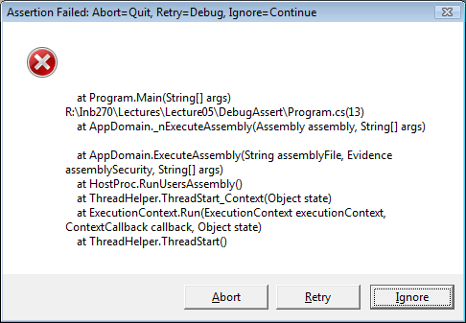
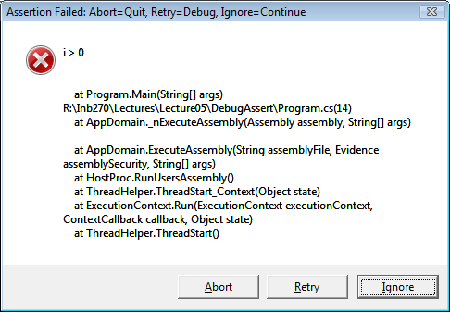
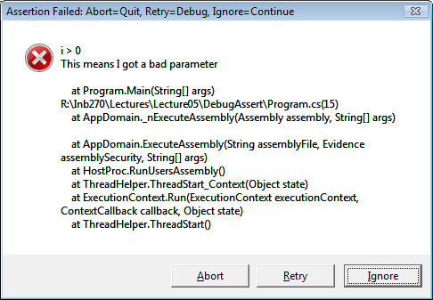
    Debug.Assert ( i > 0 );
    Debug.Assert ( i > 0, “i > 0”);
    Debug.Assert ( i > 0, “i > 0”,
    “This means I got a bad parameter”);

Slide 81
Use Assertion to Check Precondition
...PerformConversion (option)
/* precondition : option is either 1,2 3 or 4
* postcondition : appropriate calculation performed
*/
Debug.Assert ((option >= 1) && (option <= 4));
if (option == 1){
doFahToCelsius();
} else if (option == 2){
doCelsuisToFah();
} else if (option == 3){
doCelsiusToKelvin();
} else {
doFahToKelvin();
}
//end of performConversion
Extra line to check the precondition.

Slide 82
Use Assert for Debugging Only!
Use Debug.Assert for checking that your program is correct
Do not use Debug.Assert for validating user input
  i.e. don't use it for checking whether the user has entered a correct value or value type (Exceptions later…)

Slide 83
VISUAL STUDIO - keyboard shortcuts
For complete list see: http://visualstudioshortcuts.com/2017/
Ctrl+K, Ctrl+C Comment out
Ctrl+K, Ctrl+U Uncomment
Ctrl+Shift+B Build
F5 Start with debugging
Ctrl+F5 Start without debugging
Ctrl+K, Ctrl+D Format Document
Ctrl+Alt+L Show Solution Explorer window
Ctrl+Alt+O Show Output window

Slide 84
Questions??

